Slide 1
Class & Objects

Slide 2
Class
A class is a user defined blueprint or prototype from which objects are created.
It represents the set of properties or methods that are common to all objects of one type.

Slide 3
Objects
It is a basic unit of Object Oriented Programming and represents the real life entities.
A typical Java program creates many objects, which as you know, interact by invoking methods. An object consists of :
State : It is represented by attributes of an object. It also reflects the properties of an object.
Behavior : It is represented by methods of an object. It also reflects the response of an object with other objects.
Identity : It gives a unique name to an object and enables one object to interact with other objects.

Slide 4
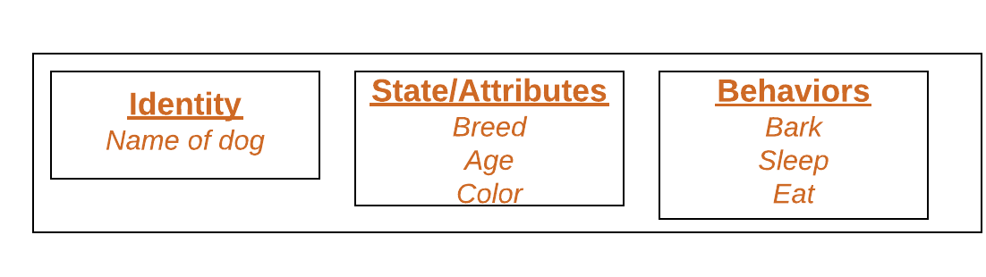
Objects

Slide 5
Declaring Objects
When an object of a class is created, the class is said to be instantiated.
All the instances share the attributes and the behavior of the class. But the values of those attributes, i.e. the state are unique for each object.
A single class may have any number of instances.
Dog dog1 = new Dog()
Dog dog2 = new Dog()
Dog dog3 = new Dog()
New operator helps to instantiate a class and allocate new memory for objects

Slide 6
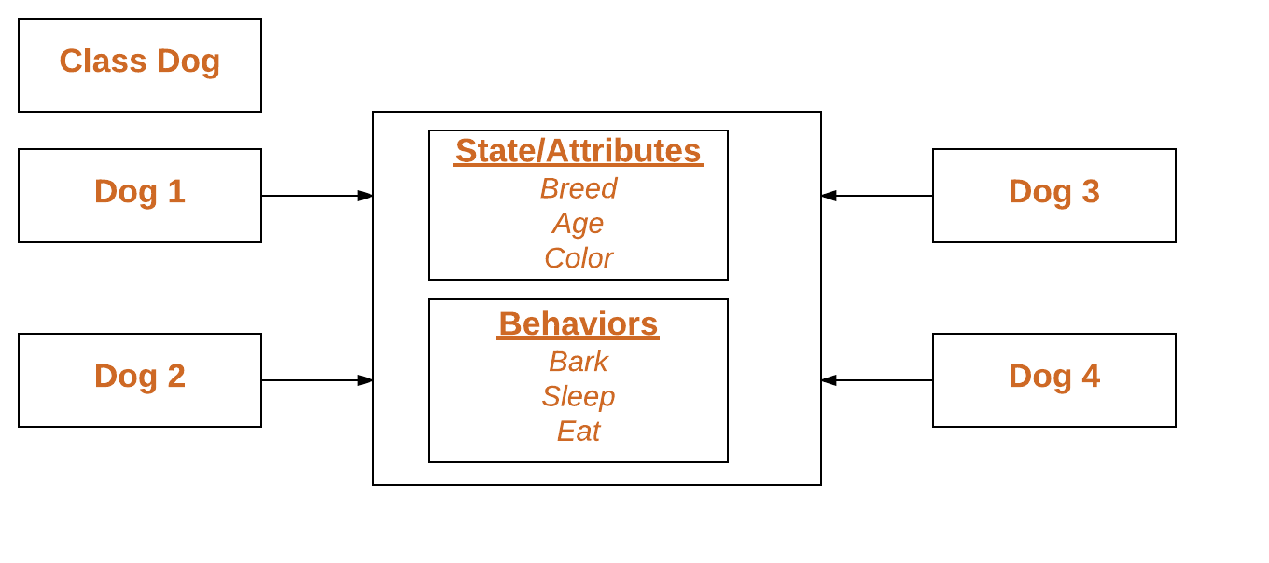

Slide 7
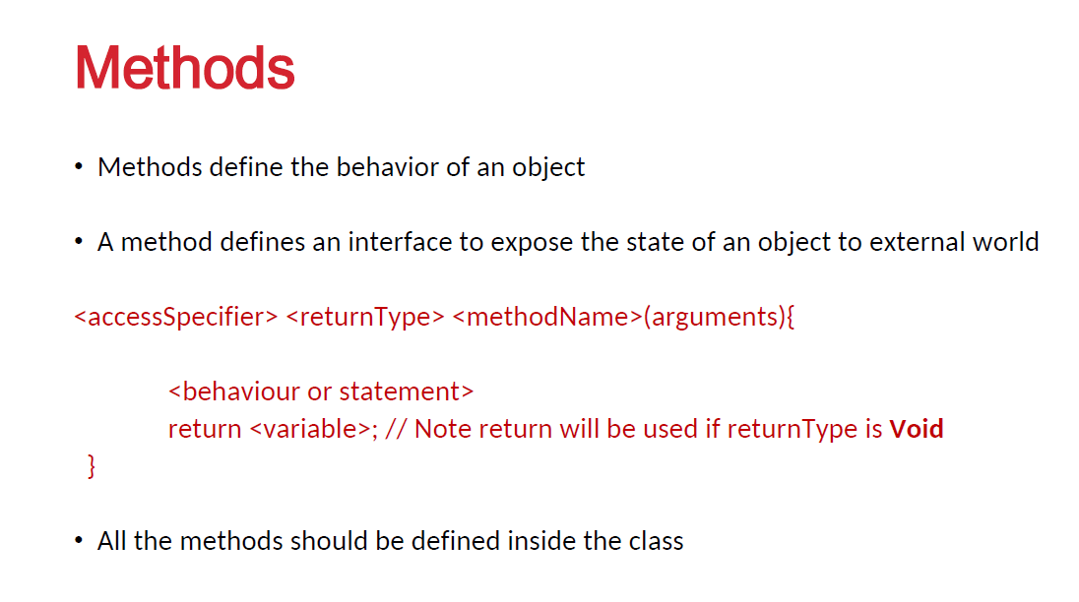

Slide 8
methods
Modifier-: Defines access type of the method i.e. from where it can be accessed in your application. In Java, there 4 type of the access specifiers.
public: accessible in all class in your application.
protected: accessible within the class in which it is defined and in its subclass(es)
private: accessible only within the class in which it is defined.
default (declared/defined without using any modifier) : accessible within same class and package within which its class is defined.
The return type : The data type of the value returned by the the method or void if does not return a value.

Slide 9
Method Name : the rules for field names apply to method names as well, but the convention is a little different.
Parameter list : Comma separated list of the input parameters are defined, preceded with their data type, within the enclosed parenthesis. If there are no parameters, you must use empty parentheses ().
Method body : it is enclosed between braces. The code you need to be executed to perform your intended operations.
<access modifier> <return type> methodname(parameter list){
}

Slide 10
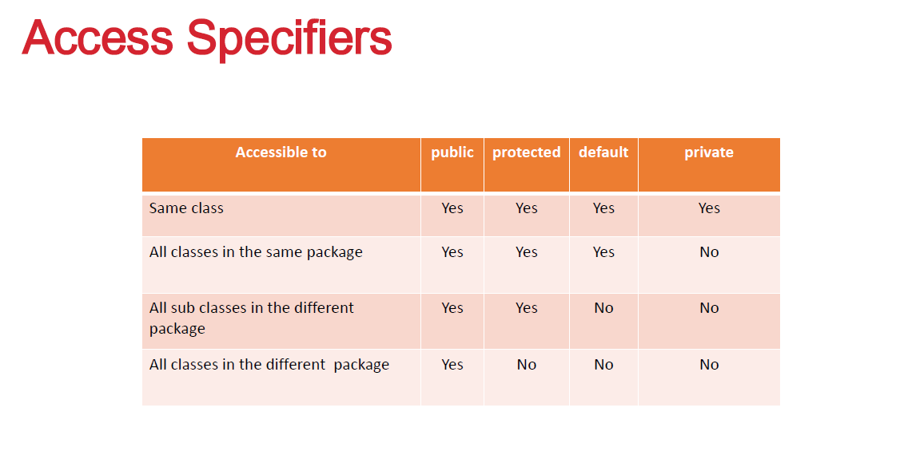

Slide 11
